Slide 1
Basic Introduction to HTML
Ms. Muskan Kumari

Slide 2
Topics to be discussed in Week 1
HTML Introduction
HTML Basic Tags : Heading, Paragraph, Hyperlink, Image
HTML Attributes
HTML Formatting
HTML Quotation and Citation Elements
HTML Comments

Slide 3
Introduction to HTML
HTML, which stands for Hypertext Markup Language, is a pretty simple language.
It consists of different elements which we use to structure a web page.
HTML consists of a series of elements
HTML elements tell the browser how to display the content
HTML elements label pieces of content such as "this is a heading", "this is a paragraph", "this is a link", etc.
We can create a static website by HTML only.
Technically, HTML is a Markup language rather than a programming language.

Slide 4
Introduction to HTML - Tag, Elements, Attributes
Tags
An HTML tag is commonly defined as a set of characters constituting a formatted command for a Web page.
At the core of HTML, tags provide the directions or recipes for the visual content that one sees on the Web.
HTML tags include tags for references, tags for tables, tags for headlines or titles, etc. An HTML tag consists of the tag name in angular brackets and may come in pair, which makes up the beginning and ending tag that frame a particular piece of code, text or other tags.
Example - <html> </html>, <p></p>

Slide 5
Elements
An element is a collection of start tag, attributes, end tag, content between them.
These elements are responsible for creating web pages and define content in that webpage.
An element in HTML usually consist of a start tag <tag name>, close tag </tag name> and content inserted between them.
Example - <p> Hello world!!! </p>

Slide 6
Attributes
HTML attributes are special words which provide additional information about the elements or attributes are the modifier of the HTML element.
Each element or tag can have attributes, which defines the behaviour of that element.
Attributes should always be applied with start tag.
The Attribute should always be applied with its name and value pair.
The Attributes name and values are case sensitive, and it is recommended by W3C that it should be written in Lowercase only.
You can add multiple attributes in one HTML element, but need to give space between two attributes.
Syntax - <element attribute_name="value">content</element>

Slide 7
Platform Used to Execute HTML Code
We write the html code on the given software and save the extension of html file is - .html/.htm.
Notepad
Notepad++
Bluefish
Aloha Editor
BBEdit
CKEditor
Brackets
And run the file on web browser like chrome, firefox, internet explorer.

Slide 8
HTML Basic Tag : Heading, Paragraph, Hyperlink
Heading
HTML headings are titles or subtitles that you want to display on a webpage.
HTML headings are defined with the <h1> to <h6> tags.
<h1> defines the most important heading. <h6> defines the least important heading.
Search engines use the headings to index the structure and content of your web pages.
Users often skim a page by its headings. It is important to use headings to show the document structure.
<h1> headings should be used for main headings, followed by <h2> headings, then the less important <h3>, and so on.
Use HTML headings for headings only. Don't use headings to make text BIG or bold.

Slide 9
Heading Example
<html>
<body>
<h1>Heading no. 1</h1>
<h2>Heading no. 2</h2>
<h3>Heading no. 3</h3>
<h4>Heading no. 4</h4>
<h5>Heading no. 5</h5>
<h6>Heading no. 6</h6>
</body>
</html>
Heading no. 1
Heading no. 2
Heading no. 3
Heading no. 4
Heading no. 5
Heading no. 6

Slide 10
HTML - Paragraph
HTML paragraph or HTML p tag is used to define a paragraph in a webpage.
A paragraph always starts on a new line, and browsers automatically add some white space (a margin) before and after a paragraph.
A paragraph always starts on a new line, and is usually a block of text.
The HTML <p> element defines a paragraph.
<html>
<body>
<p>This is a paragraph.</p>
<p>This is a paragraph.</p>
Output:
This is a paragraph.
This is a paragraph.
This is a paragraph.
<p>This is a paragraph.</p>
</body>
</html>

Slide 11
HTML Tag - Hyperlink
HTML links are hyperlinks.
You can click on a link and jump to another document.
When you move the mouse over a link, the mouse arrow will turn into a little hand.
The HTML <a> tag defines a hyperlink. It has the following syntax:
<a href="url">link text</a>
The most important attribute of the <a> element is the href attribute, which indicates the link's destination.
The link text is the part that will be visible to the reader.
Clicking on the link text, will send the reader to the specified URL address.

Slide 12
Example - Hyperlink
<html>
<body>
<h1>HTML Links</h1>
<p><a href="https://www.www.amazon.com/">Visit amazon.com!</a></p>
</body>
</html>

Slide 13
Output:
HTML Links
Visit amazon.com!

Slide 14
HTML - Image
HTML img tag is used to display image on the web page.
HTML img tag is an empty tag that contains attributes only, closing tags are not used in HTML image element.
The <img> tag is empty, it contains attributes only, and does not have a closing tag.
The <img> tag has two required attributes:
src - Specifies the path to the image
alt - Specifies an alternate text for the image

Slide 15

Example
<html>
<body>
<h2>HTML Image Example</h2>
<img src="good-morning.jpg" alt="Good Morning Friends"/>
</body>
</html>

Slide 16
Attributes of HTML img tag
The src and alt are important attributes of HTML img tag. All attributes of HTML image tag are given below.
1) src - It is a necessary attribute that describes the source or path of the image. It instructs the browser where to look for the image on the server.
The location of image may be on the same directory or another server.
2) alt - The alt attribute defines an alternate text for the image, if it can't be displayed. The value of the alt attribute describe the image in words. The alt attribute is considered good for SEO prospective.

Slide 17
Attributes of HTML img tag
3) width - It is an optional attribute which is used to specify the width to display the image. It is not recommended now. You should apply CSS in place of width attribute.
4) height - It h3 the height of the image. The HTML height attribute also supports iframe, image and object elements. It is not recommended now. You should apply CSS in place of height attribute.
Example:
<img src="animal.jpg" height="180" width="300" alt="animal image">

Slide 18
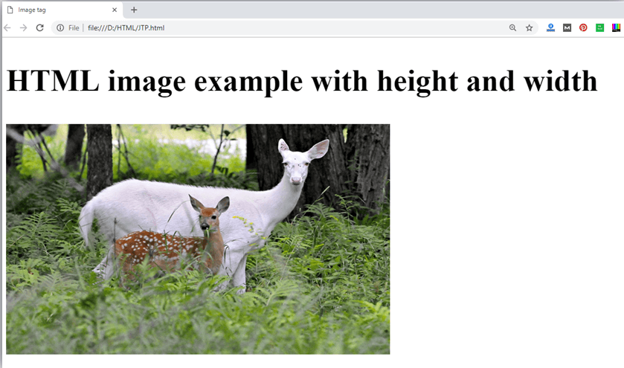
Example
<html><head>
<title>Image tag</title></head>
<body>
<h2>HTML image example with height and width</h2>
<img src="https://static.picture.com/htmlpages/images/animal.jpg" height="180" width="300" alt="animal image">
</body></html>

Slide 19
How to get image from another directory/folder?
To insert an image in your web, that image must be present in your same folder where you have put the HTML file. But if in some case image is available in some other directory then you can access the image by mention the path of image like :
<img src="E:/images/animal.png" height="180" width="300" alt="animal image">

Slide 20
Use <img> tag as a link
<html>
<head><title>Image tag</title> </head>
<body><h2>Use image as a link</h2>
<p>Click on the image to know about robotics</p>
<a href="https://www.learning.com/what-is-robotics"><img src="https://static.picture.com/htmlpages/images/robot.jpg" height="100" width="100"></a>
</body></html>

Slide 21

Output:
Use image as a link
Click on the image to know about robotics

Slide 22
HTML Formatting
HTML Formatting is a process of formatting text for better look and feel. HTML provides us ability to format text without using CSS. There are many formatting tags in HTML. These tags are used to make text bold, italicized, or underlined. There are almost 14 options available that how text appears in HTML and XHTML.
In HTML the formatting tags are divided into two categories:
Physical tag: These tags are used to provide the visual appearance to the text.
Logical tag: These tags are used to add some logical or semantic value to the text.

Slide 23
14 HTML formatting tags. Following is the list of HTML formatting text.
Element name Description
<b> This is a physical tag, which is used to bold the text written between it.
<strong> This is a logical tag, which tells the browser that the text is important.
<i> This is a physical tag which is used to make text italic.
<em> This is a logical tag which is used to display content in italic.
<mark> This tag is used to highlight text.
<u> This tag is used to underline text written between it.

Slide 24
<tt> This tag is used to appear a text in teletype. (not supported in HTML5)
<strike> This tag is used to draw a strikethrough on a section of text. (Not supported in HTML5)
<sup> It displays the content slightly above the normal line.
<sub> It displays the content slightly below the normal line.
<del> This tag is used to display the deleted content.
<ins> This tag displays the content which is added
<big> This tag is used to increase the font size by one conventional unit.
<small> This tag is used to decrease the font size by one unit from base font size.

Slide 25
HTML Quotation and Citation Elements
HTML <blockquote> for Quotations
The HTML <blockquote> element defines a section that is quoted from another source.
Browsers usually indent <blockquote> elements.
<p>Here is a quote from WWF's website:</p>
<blockquote cite="http://www.worldwildlife.org/who/index.html">
For 50 years, WWF has been protecting the future of nature.
The world's leading conservation organization,
WWF works in 100 countries and is supported by
1.2 million members in the United States and
close to 5 million globally.
</blockquote>

Slide 26
output
Browsers usually indent blockquote elements.
For nearly 60 years, WWF has been protecting the future of nature. The world's leading conservation organization, WWF works in 100 countries and is supported by more than one million members in the United States and close to five million globally.

Slide 27
HTML <q> for Short Quotations
The HTML <q> tag defines a short quotation.
Browsers normally insert quotation marks around the quotation.
<html><body>
<p>Browsers usually insert quotation marks around the q element.</p>
<p>WWF's goal is to: <q>Build a future where people live in harmony with nature.</q></p>
</body></html>

Slide 28
output
Browsers usually insert quotation marks around the q element.
WWF's goal is to: Build a future where people live in harmony with nature.

Slide 29
THANK
YOU

